Slide 1

Suicide Trends Analysis in India
Based on Educational Status
Tools Used: Python, Pandas, Matplotlib
~ Sayali Kamble
Data Source: India Data Portal, Government of India (Open Data Initiative)
© All rights reserved by Fireblaze Technologies Pvt. Ltd.

Slide 2
Problem Statement
Suicide remains a critical socio-economic and public health challenge in India, with complex underlying factors influenced by education, gender, and regional disparities.
Despite the availability of government data, there is a lack of structured analysis to understand how educational attainment impacts suicide trends over time.
Identifying patterns across different educational groups is essential to recognize vulnerable populations and underlying risk factors.
There is a need for a data-driven approach to explore temporal, demographic, and regional variations in suicide cases.
This project uses data analytics to generate insights for decision-making and policy development.
© All rights reserved by Fireblaze Technologies Pvt. Ltd.

Slide 3
About the Data
It contains information on suicide cases categorized by educational status across multiple years.
The dataset is obtained from the India Data Portal, an official Government of India open data platform.
Key attributes include Year, State, Gender, Education Level, and Number of Deaths.
The dataset is structured and suitable for performing exploratory data analysis (EDA) and visualization.
The dataset enables in-depth analysis of social patterns and supports data-driven insights.
© All rights reserved by Fireblaze Technologies Pvt. Ltd.

Slide 4
Proposed Solution / Methodology
Collected and loaded the dataset from India Data Portal for analysis.
Performed data cleaning by handling missing values and ensuring data consistency.
Conducted exploratory data analysis (EDA) to understand trends and patterns.
Analyzed suicide cases based on educational status, gender, year, and region.
Used data visualization techniques (bar charts, line graphs, pie charts) to represent insights.
Interpreted results to identify key patterns and high-risk groups.
© All rights reserved by Fireblaze Technologies Pvt. Ltd.

Slide 5
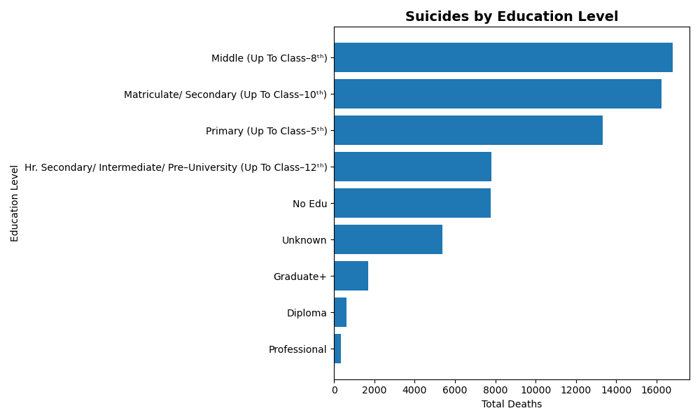
Insights
Q.1 Education-wise Analysis
Suicide cases are highest among middle-level education (up to class 8th)
Secondary education group also shows high number of cases
Cases decrease as education level increases
Higher education groups like graduates and professionals show very low cases
Overall, lower and middle education groups are more affected
© All rights reserved by Fireblaze Technologies Pvt. Ltd.

Slide 6
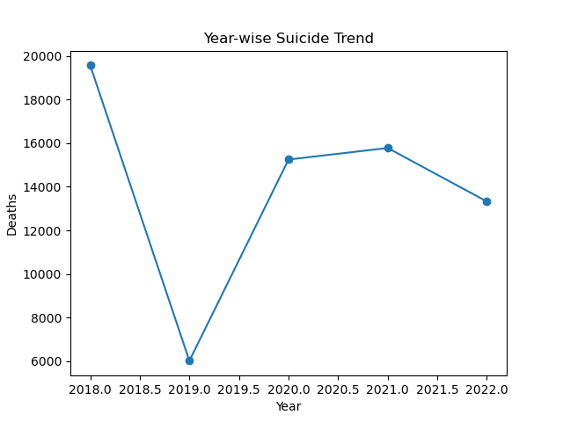
Insights
Q.2 Year-wise Suicide Trend Analysis
Suicide cases were highest in 2018
There is a sharp drop in 2019
Cases increase again in 2020 and 2021
Slight decline observed in 2022
Overall trend shows fluctuating pattern over years
© All rights reserved by Fireblaze Technologies Pvt. Ltd.

Slide 7
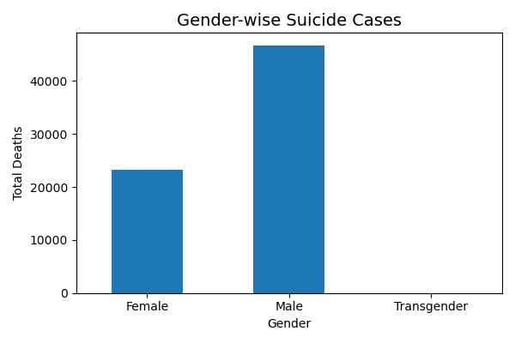
Insights
Q.3 Gender Wise Suicide
Suicide cases are significantly higher among males compared to females
“Males contribute the majority of suicide cases, indicating a critical need for targeted mental health support.”
There is a clear gender gap, with males being the most affected group
Societal pressure and economic responsibility may contribute to higher male suicide rates
© All rights reserved by Fireblaze Technologies Pvt. Ltd.

Slide 8
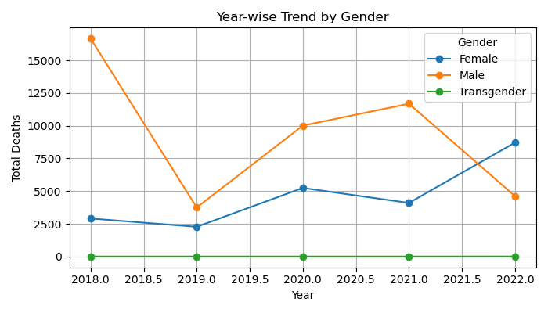
Insights
Q.4 Gender-wise Suicide Trend Over Years
Male suicide cases remain consistently higher across all years
There is a sharp decline in 2019, followed by recovery in later years
Female cases show a gradual increase over time
“Despite fluctuations, the gender gap remains significant over the years.”
© All rights reserved by Fireblaze Technologies Pvt. Ltd.

Slide 9
Conclusion
Suicide cases are highest among lower and middle education groups.
Higher education groups show significantly lower cases
Male population is the most affected, showing a significant gender gap.
Suicide trends show fluctuations over the years, with no consistent decline
“This analysis emphasizes the need for targeted mental health awareness, early intervention, and support systems for high-risk groups.”
© All rights reserved by Fireblaze Technologies Pvt. Ltd.

Slide 10
Future Scope
Include more recent and detailed data for better trend analysis.
Perform state-wise and district-level analysis to identify regional patterns.
Use machine learning models to predict high-risk groups.
Study additional factors like economic conditions, occupation, and social factors.
Develop data-driven policies and awareness programs for prevention
© All rights reserved by Fireblaze Technologies Pvt. Ltd.

